Slide 1



RNN, LSTM and CNN
INTRODUCTION TO MACHINE LEARNING
- Ashwina Rakish

Slide 2
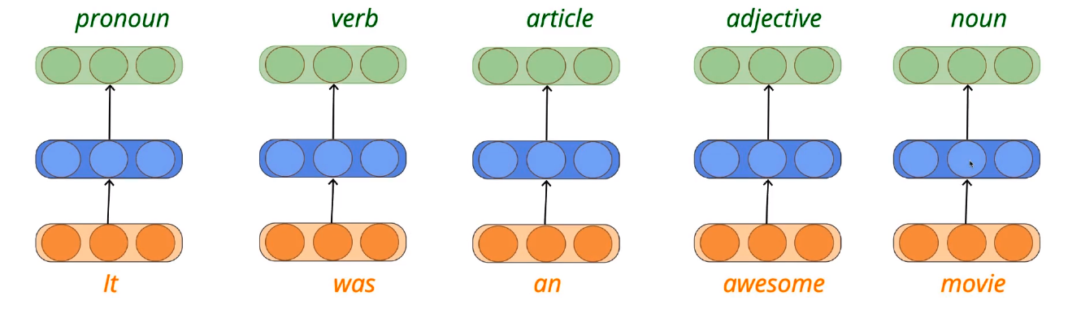
Why RNN?
Sequential Learning Problem: Previous outputs are required for the next prediction.

Slide 3
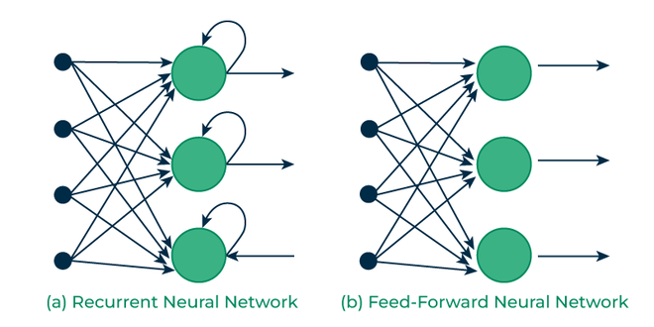
Recurrent Neural Networks - RNNs

Slide 4
RNN
The RNN takes an input vector X and the network generates an
output vector y by scanning the data sequentially from left to right, with each time step updating the hidden state and producing an output.
Much like ANNs, RNNs also has an input, hidden and output layer.
But there are 2 major differences:
1. Input is fed to the network on a timestep basis i.e. at t=1 we
send X11 to the network, at t=2 we send X22 and so on.
2. ANN is feed-forward whereas RNNs have a concept of state.

Slide 5
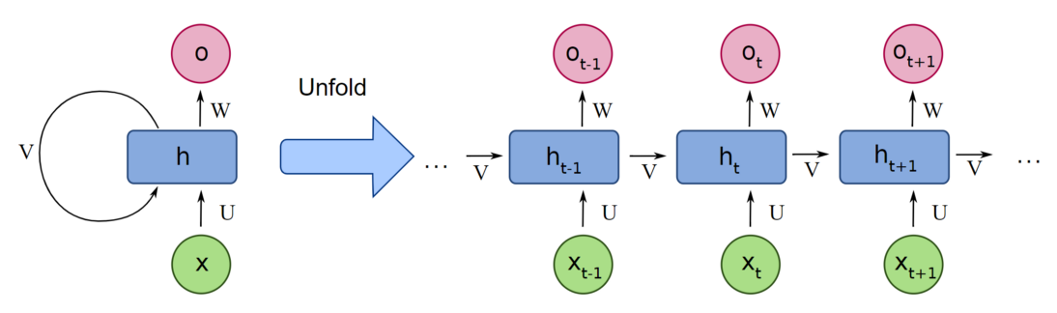
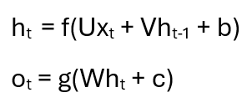
How does it work?
Here ,X is input, h is the hidden state, U,V and W are weights and O is output

Slide 6
LSTM
A traditional RNN has a single hidden state that is passed through time, which can make it difficult for the network to learn long-term dependencies.
LSTMs address this problem by introducing a memory cell, which is a container that can hold information for an extended period.
LSTM networks are capable of learning long-term dependencies in sequential data, which makes them well-suited for tasks such as language translation, speech recognition, and time series forecasting.

Slide 7
LSTM
Three gates input gate, forget gate, and output gate are all implemented using sigmoid functions, which produce an output between 0 and 1. These gates are trained using a backpropagation algorithm through the network.
The input gate decides which information to store in the memory cell. It is trained to open when the input is important and close when it is not. – Selective Read
The forget gate decides which information to discard from the memory cell. It is trained to open when the information is no longer important and close when it is. – Selective Forget
The output gate is responsible for deciding which information to use for the output of the LSTM. It is trained to open when the information is important and close when it is not. – Selective Write

Slide 8
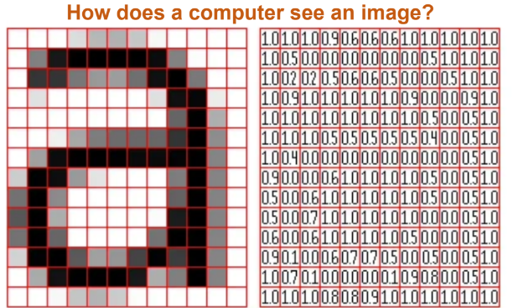
Convolutional Neural Networks

Slide 9
Convolutional Neural Networks?
CNNs are a type of deep neural network architecture designed for processing structured grid-like data, such as images.
They consist of multiple layers, including convolutional layers, pooling layers, and fully connected layers (in some architectures).
The core building blocks of CNNs are convolutional layers, which apply convolution operations to the input data.
Convolutional filters (also known as kernels) are applied across the input data to extract local features.
These filters are learned during training and capture patterns such as edges, textures, and shapes.
Pooling layers are used to reduce the spatial dimensions of the feature maps produced by convolutional layers.(max pooling and average)

Slide 10
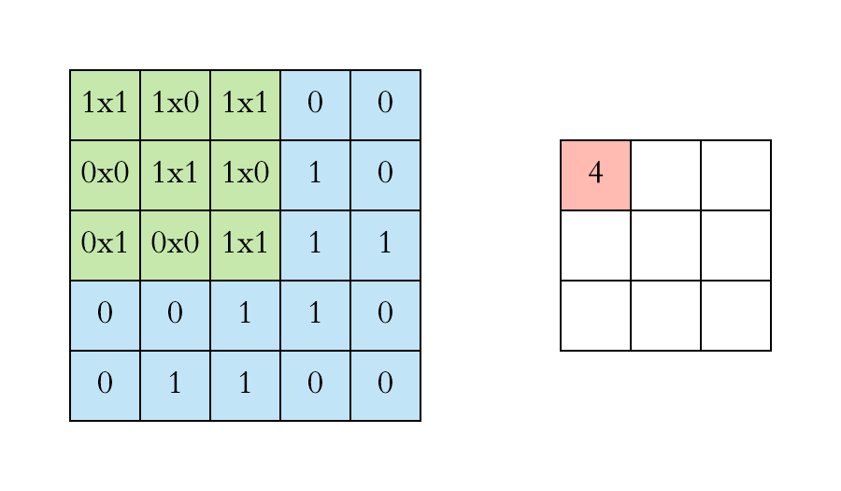
How does it work? – Convolution Layer

Slide 11
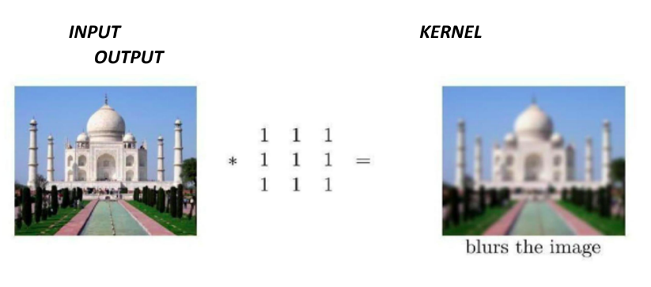
Effects of Convolution

Slide 12
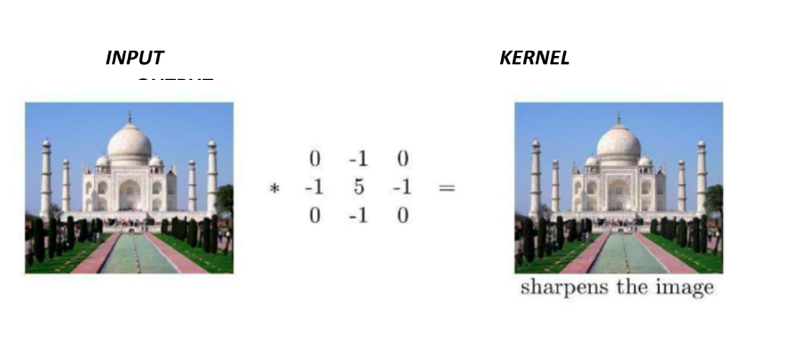
Effects of Convolution

Slide 13
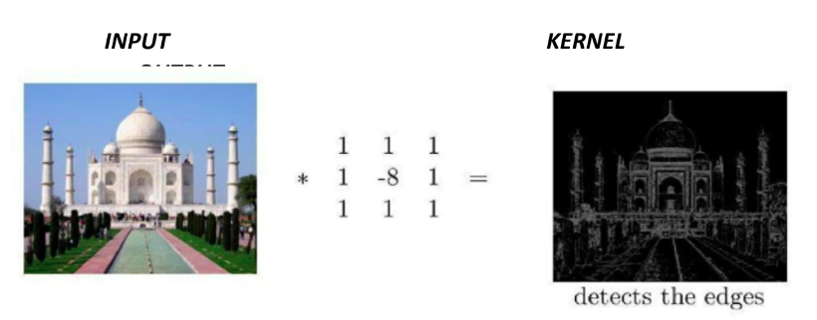
Effects of Convolution

Slide 14

How does it work? – Pooling Layer

Slide 15
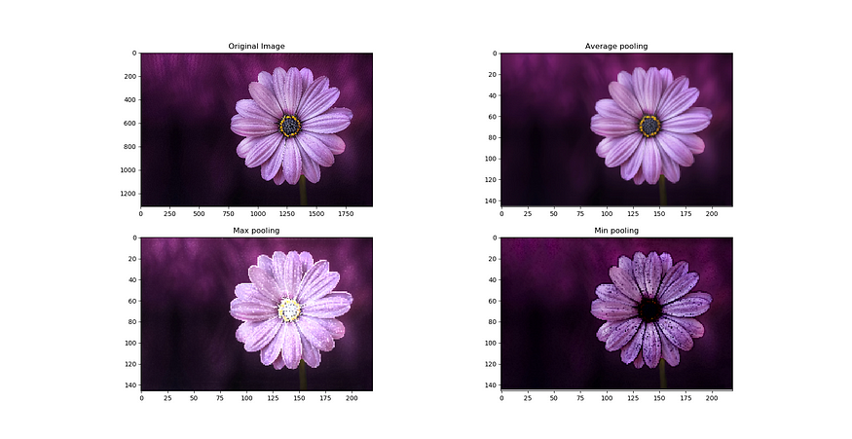
Effects of Pooling

Slide 16

How do all the layers come together?

Slide 17
QUIZ

Slide 18
Question: What are the three gates in LSTM?
Answer: Input gate, forget gate, output gate

Slide 19
Question: Is LSTM a variation of RNN?
Answer: Yes

Slide 20
Question: What extra component does an RNN have?
Answer: Hidden states

Slide 21
Question: I performed an operation and extracted the edges from the image, is it convolution or pooling?
Answer: Convolution

Slide 22
Question: I performed an operation and the image became darker, is it convolution or pooling?
Answer: Pooling

Slide 23
Question: When I perform convolution does the image dimension decrease?
Answer: Yes

Slide 24
Question: When I perform pooling does the image dimension decrease
Answer: Yes

Slide 25
Thank You!

